Slide 1

Exploratory data analysis tool.
Team Members:
Appana Venkata Raju Sai -21BIT0589
Komaravolu Sriram -21BIT0491
Madupalli Kaushal -21BIT0506

Slide 2
Agenda
Introduction
Technologies Used
Overview of Core Features of the Website.
Workflow
Architectural design
User Interface (UI)
Page-by-Page Breakdown
Visual Insights: Exploring EDA Features in the EDA TOOL
Summary

Slide 3
Introduction
Objective: Develop an interactive web app to streamline Exploratory Data Analysis (EDA) through dynamic visualizations. Users can upload datasets and generate customizable charts, enabling quick exploration of data trends and relationships.
Motivation: Simplify the traditionally complex EDA process, reducing the need for coding while enhancing speed, accuracy, and flexibility for data analysts. Address the growing demand for efficient, user-friendly tools.
Background: EDA helps in understanding data patterns, detecting outliers, and finding variable relationships. Tools like this enables non-technical users to perform EDA without requiring advanced coding skills, making the process faster and more accessible.

Slide 4

Technologies Used
Streamlit
Python
Pandas
Ploty
Base64
Numpy

Slide 5

Dataset Upload Overview
Formats: Supports CSV and XLSX.
Simple Interface: Easy file selection with drag-and-drop.
Real-Time Feedback: Preview data immediately after upload.

Slide 6

Data Visualization Overview
Diverse Visualization Options: The tool provides a wide range of graphical representations, enabling users to uncover data distributions, trends, and relationships effectively.
Customization: Adjust color schemes and filters interactively.
Data Filtering: Explore and refine insights with real-time filtering for better analysis.

Slide 7
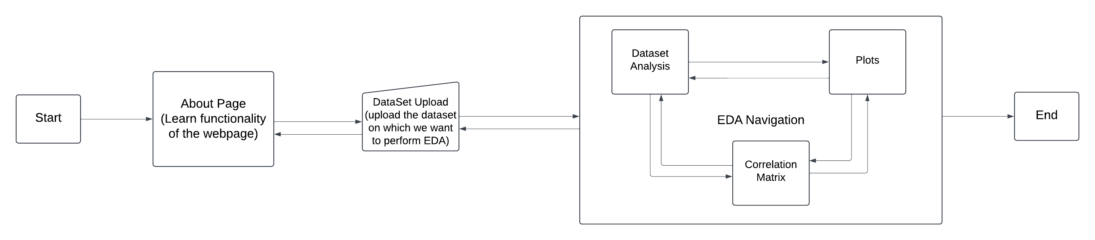
Workflow

Slide 8
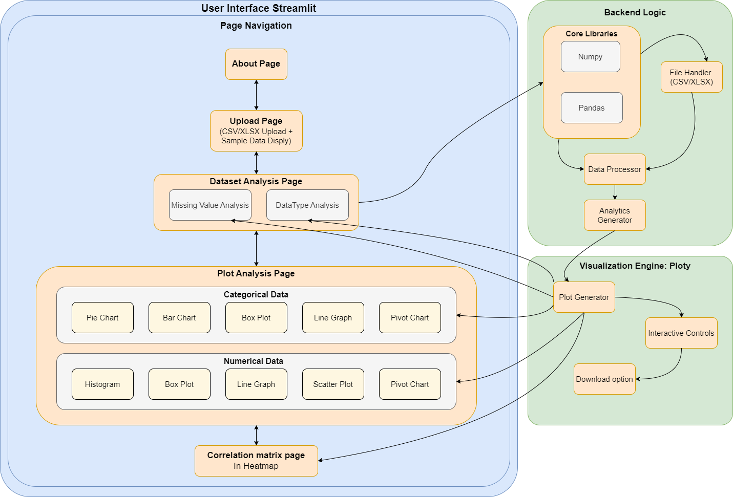
Architectural design
Architecture of Streamlit-based EDA App
1. User Interface (Streamlit)
Page Navigation: Easy transitions between features.
About Page: Overview and instructions.
Upload Page: Upload and preview datasets (CSV/XLSX).
Dataset Analysis: Analyze missing values and data types.
Plot Analysis:
Categorical: Pie, Bar, Box, Line, Pivot Charts.
Numerical: Histograms, Box, Line, Scatter, Pivot Charts.
Correlation Matrix: Heatmap for numerical correlations.

Slide 9
Architectural design
2. Backend Logic
Core Libraries: Numpy, Pandas for data manipulation.
File Handler: Manages dataset uploads.
Data Processor: Analyzes missing values and data types.
Analytics Generator: Transforms data for visualizations.
3. Visualization Engine (Plotly)
Plot Generator: Creates interactive graphs.
Interactive Controls: Customizable visualizations.
Download Option: Save visualizations.

Slide 10
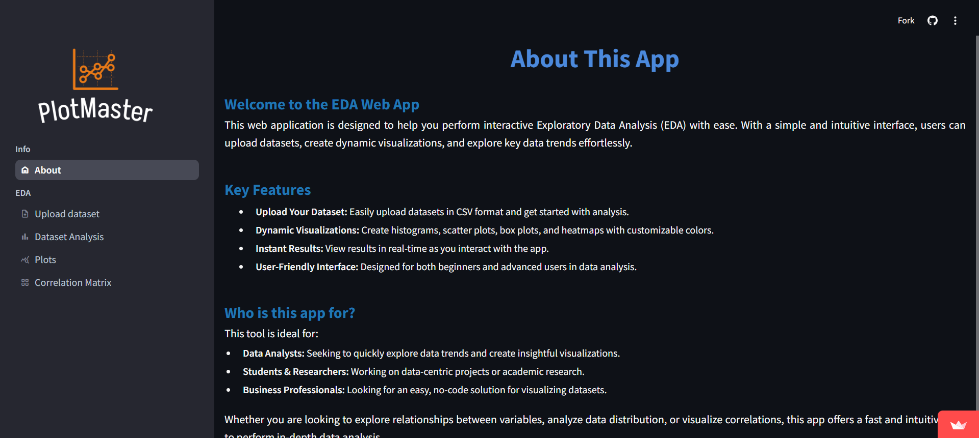
User Interface (UI)

Slide 11
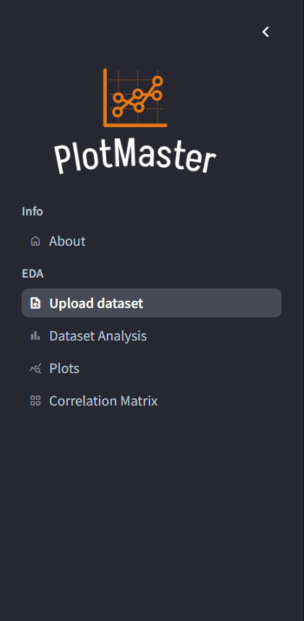
UI Element: Navigation Bar
Purpose: Provides easy access to core functionalities of the app.
Key Features:
Dataset Upload: Quickly upload new datasets with minimal clicks.
Visualization Tools: Access various visualization options for data analysis.
User Experience: Streamlined navigation enhances workflow efficiency for both technical and non-technical users.

Slide 12
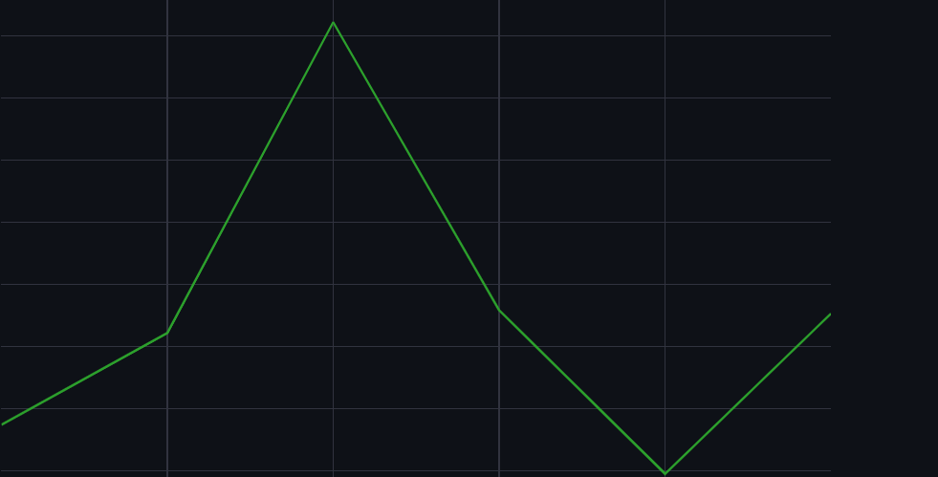
UI Element: Visualization Panel
Displays charts and graphs generated from user-selected data, making it easy to switch between different types of visual representations.

Slide 13
Understanding EDA Tool: Page-by-Page Breakdown"
Each page plays a critical role in the EDA process, guiding users through data upload, analysis, visualization, and correlation matrix generation.
The sidebar allows easy navigation between key pages such as ‘Upload dataset,’ ‘Dataset Analysis,’ ‘Plots,’ and ‘Correlation Matrix,’ making the workflow seamless.
Users can interact with their data in real-time, with customizable options that enhance both usability and insights.

Slide 14
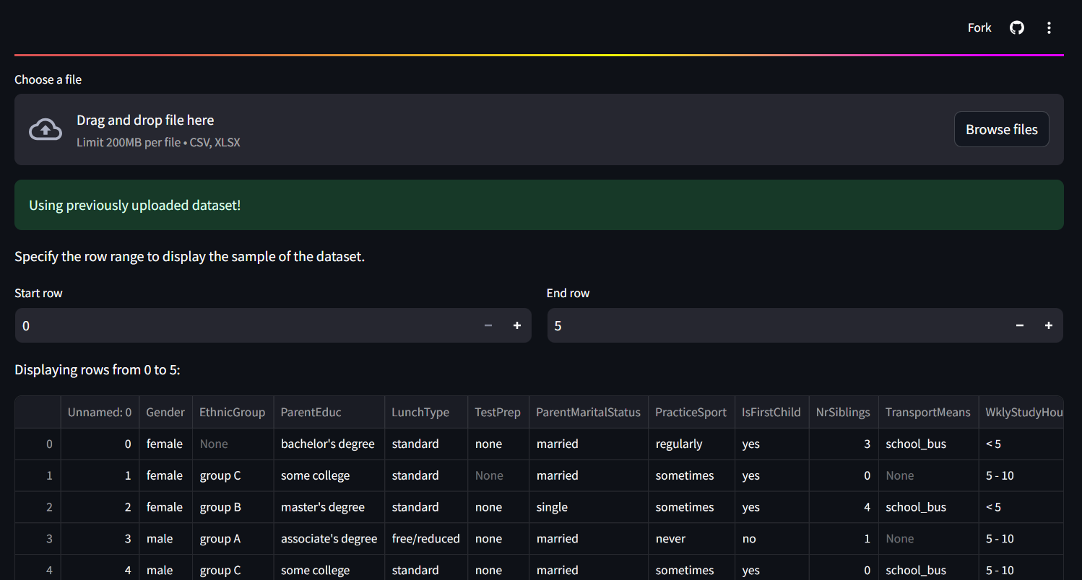
Dataset Upload
Step 1: Upload Dataset
Users upload datasets in CSV or XLSX format through a simple interface.
Step 2: Validation
Immediate validation to ensure data integrity and compatibility.
Step 3: Preview
Display a preview of the uploaded data for user verification before analysis.

Slide 15
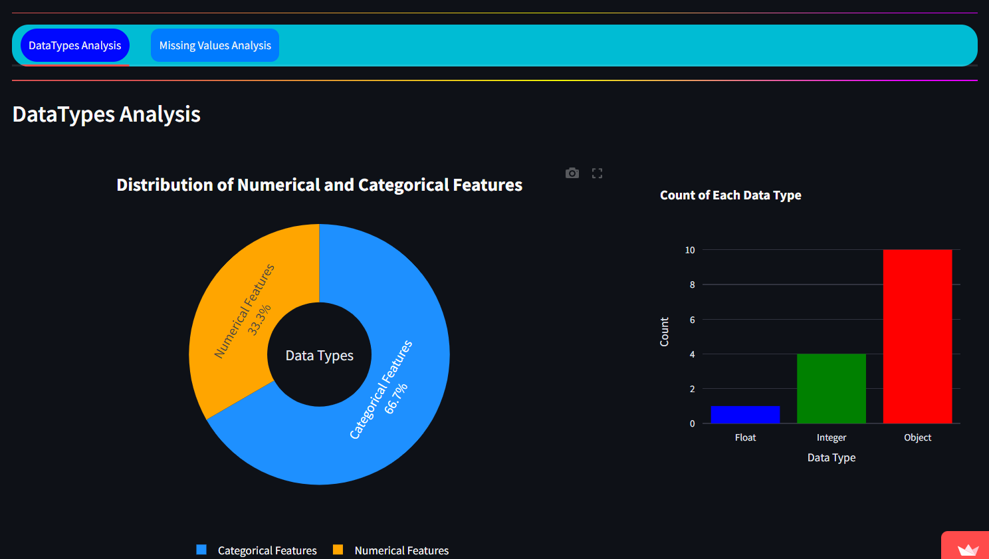
Dataset Analysis : Data Type Analysis
The Data Types Analysis section provides a detailed breakdown of the numerical and categorical features within the dataset.
A donut chart illustrates the percentage distribution of Categorical Features and Numerical Features, giving users an immediate understanding of the dataset’s composition.
The bar chart to the right shows the count of each data type, revealing that the dataset includes Object (categorical) data, Integer, and Float types, with Object being the most frequent.
Users can toggle between DataTypes Analysis and Missing Values Analysis at the top, enabling a flexible approach to examining the dataset.

Slide 16
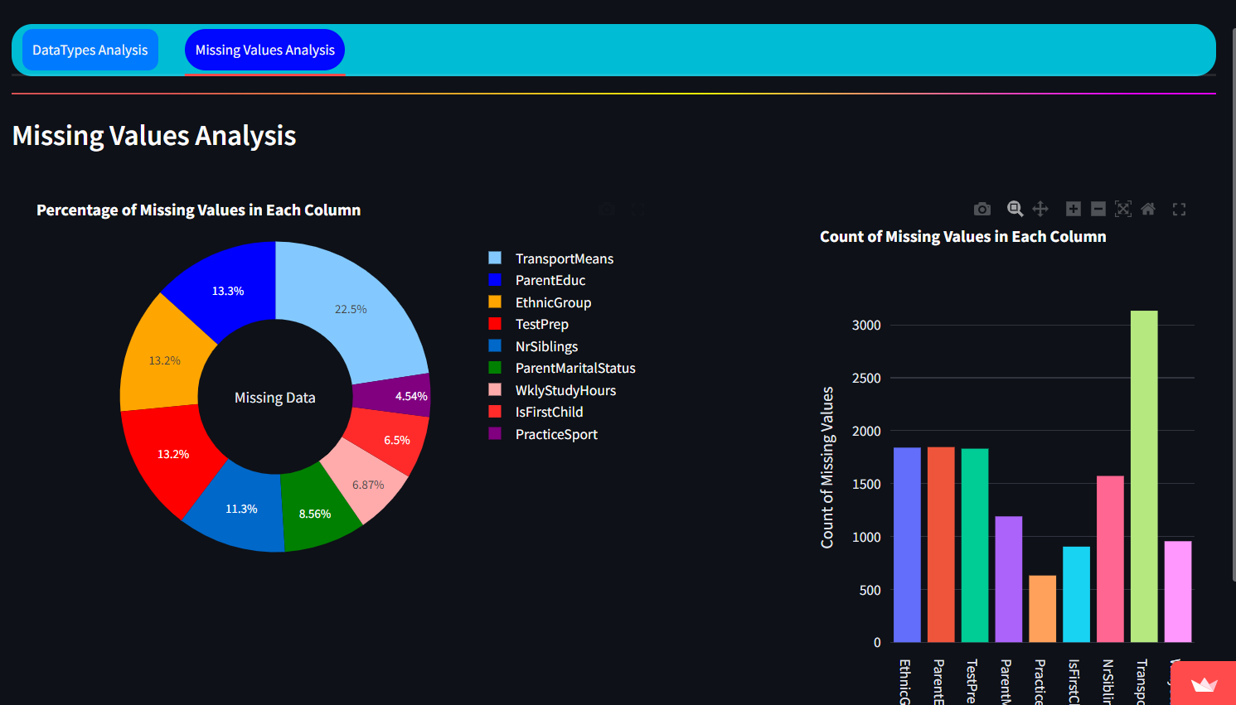
Dataset Analysis: Missing Values Analysis
This page highlights the percentage of missing values across different columns, displayed via a donut chart.
A bar chart further details the count of missing values in each column
This analysis allows users to quickly identify columns with significant missing data, helping them make decisions about data cleaning or imputation strategies.
Implement functionality to selectively include or exclude specific columns when generating the missing values donut graph, enhancing the visual representation and focus on relevant data.
We offer features that allow users to zoom in on the graph for detailed analysis, download the analysis image, and utilize autoscale and reset axes functionalities for enhanced data visualization.

Slide 17


Image Customization and Interaction Options
The image illustrates the buttons utilized for an enhanced examination of the graph.
This feature allows users to download the analysis graph for easy access and sharing
The selected area can be zoomed in for a more detailed view of the data.
The pan feature allows users to smoothly navigate across the graph for exploring different data sections without altering the zoom level.
Clicking the plus icon zooms in on the entire graph, providing a closer view of the data.
Clicking the minus icon zooms out, offering a broader view of the entire graph.
The Autoscale feature automatically adjusts the graph's axes to fit the data, ensuring optimal visibility and a clear representation of all data points without manual scaling.
The reset axis functionality restores the graph's axes to their default scale, undoing any zooming, panning, or custom adjustments, and returning the view to its original state.
The full screen button expands the graph to occupy the entire screen, providing an immersive, detailed view for enhanced analysis.

Slide 18
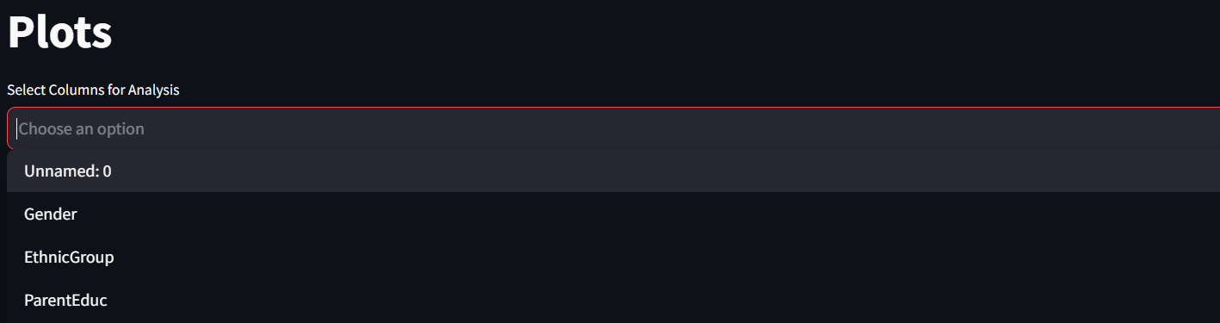
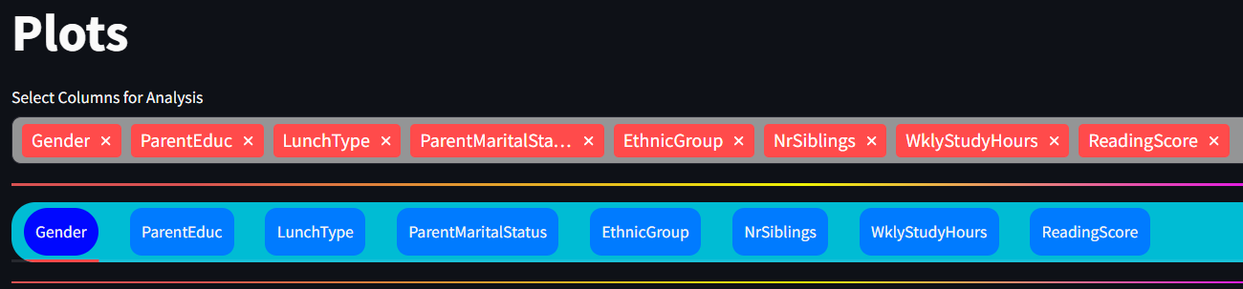
Plots:
Visual Insights: Exploring EDA Features in the EDA TOOL
On the Plots page, users must first select the columns they wish to analyze.
After selecting the desired columns, users can choose a specific column for analysis based on their requirements.

Slide 19
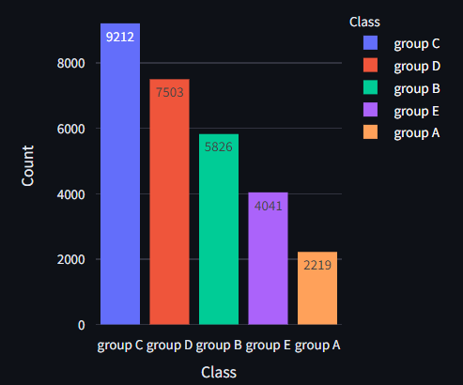
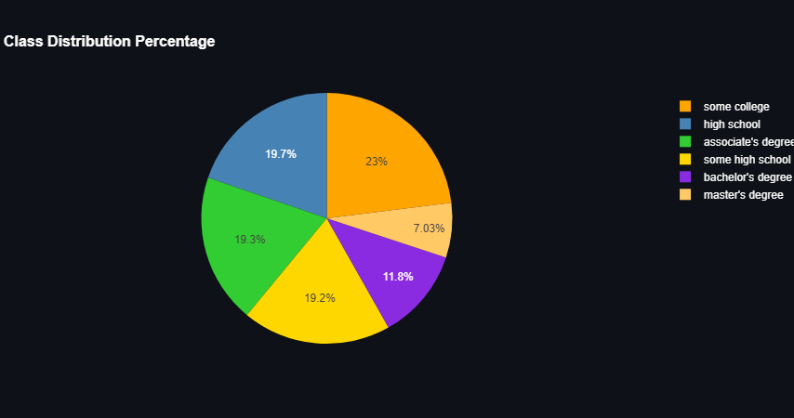
Feature Analysis (for categorial variable)
If the selected attribute is a categorical variable, a pie chart will be displayed to illustrate the distribution of values, along with a bar graph showcasing the count of each value within that attribute.

Slide 20
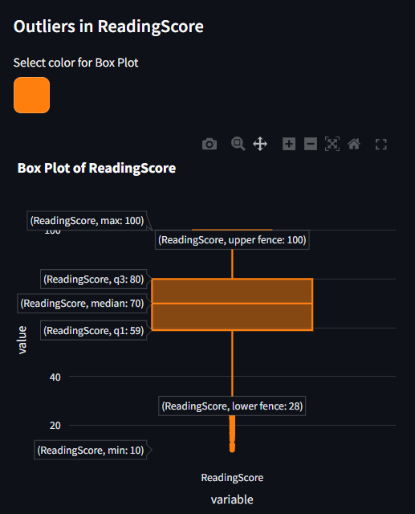
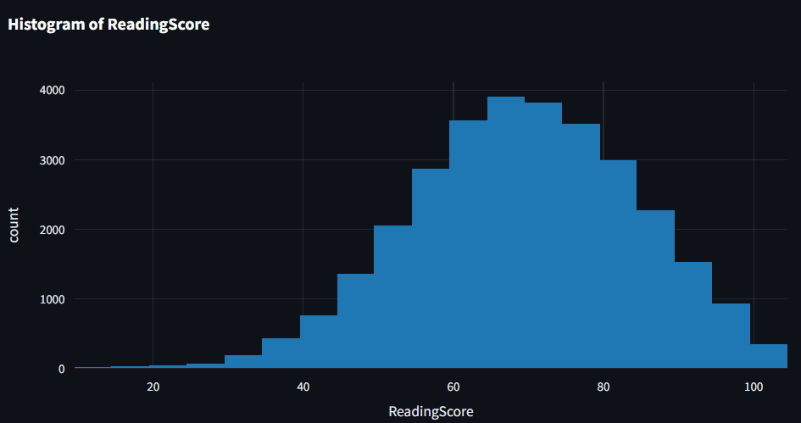
Feature Analysis (for numerical variable)
If the selected attribute is a numerical variable, a histogram will be presented along with outlier analysis using a box plot for that attribute.

Slide 21
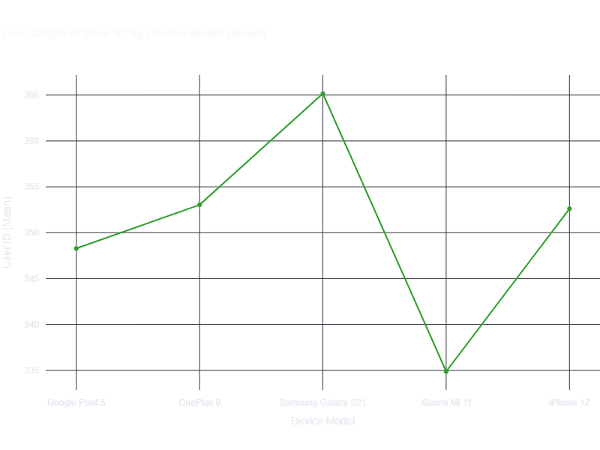
Plots-Line graph
Dynamic Visualization: Provides an effective visual representation of trends over time, enabling easy identification of patterns.
Statistical Metrics: Options included
Mean: Average value for central tendency.
Sum: Total value for cumulative analysis.
Count: Total observations for data volume.
Min/Max: Range insights from minimum and maximum values.
Median: Middle value, robust against outliers.
Y-Axis Customization: Allows selection of another attribute for analysis, enhancing focus and clarity.
Interactive Elements:Tooltips provide detailed data insights on hover.
Export Options: Downloadable as an image or data file for reporting purposes.

Slide 22
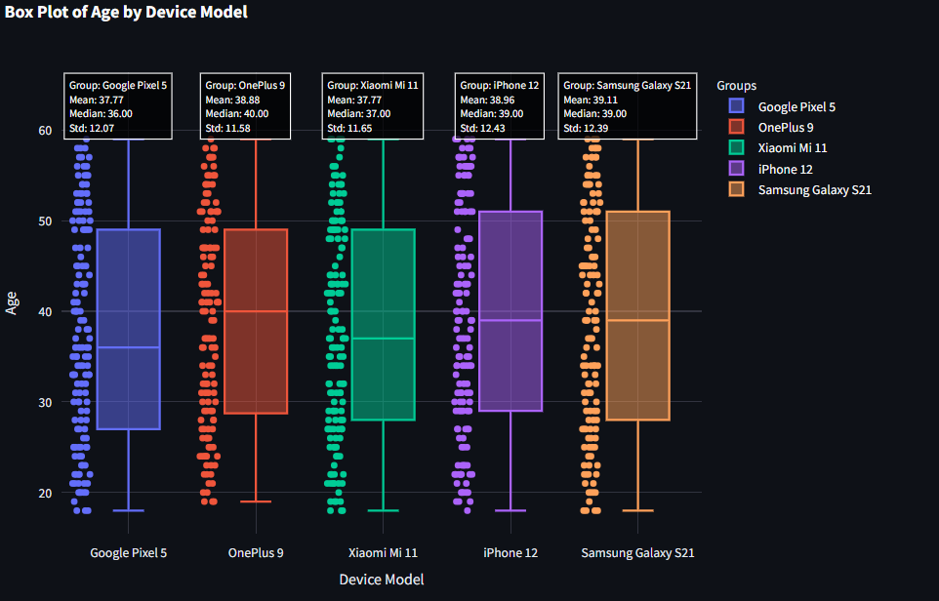
Box plot
Comprehensive Visualization: The box plot provides a clear summary of data distribution, highlighting the central tendency, spread, and variability of values for the selected y-axis attribute.
Y-Axis Customization: Users can choose another attribute to analyze, allowing for focused insights into specific data relationships
Display Options:
No Points: Presents only the box plot without individual data points for a cleaner view.
Outliers Only: Displays only the outlier points, helping to identify anomalies in the dataset.
All Points: Shows all individual data points alongside the box plot, facilitating detailed analysis of data distribution.
Statistical Insights: Visualizes key statistics, including the median, quartiles, and potential outliers, providing a robust summary of the dataset.
Comparison Across Groups: Enables easy comparison of distributions across different categories or groups within the dataset.
Interactive Features: Users can interact with the plot for detailed insights, enhancing data exploration.
Export Options: The box plot can be downloaded as an image or data file for reporting and further analysis.

Slide 23
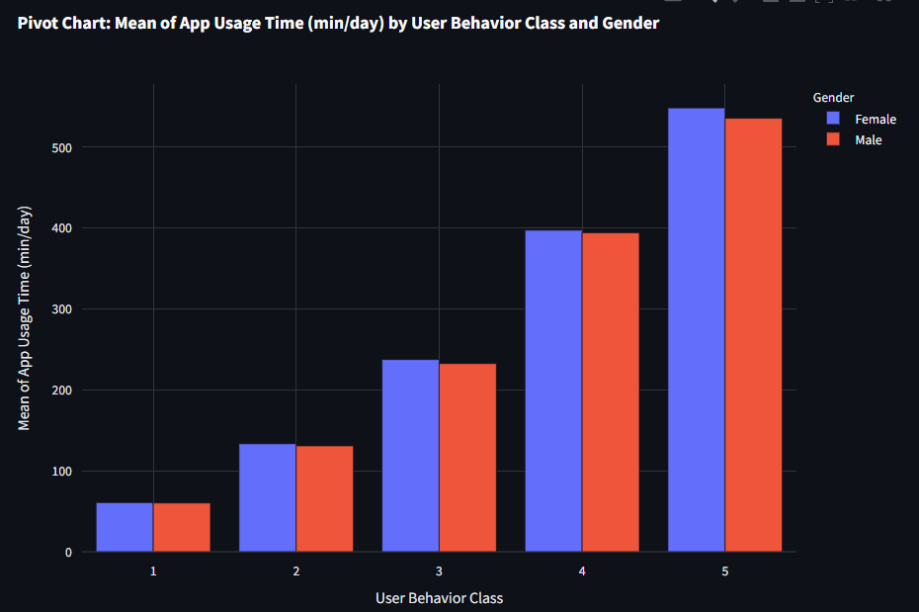
Pivot Chart
Dynamic Data Summarization: The pivot chart allows users to visualize aggregated data effectively, making it easy to interpret complex datasets.
Select Y-Axis: Choose a specific attribute for focused analysis.
Select Column Group: Group by additional columns for comparative insights.
Aggregation Selection: Options included:
Mean: Average value for central tendency.
Sum: Total value for cumulative insights.
Count: Total observations for data volume.
Min: Minimum value for lower bound analysis.
Max: Maximum value for upper limit perspective.
Comprehensive Insights: Uncover trends and relationships to enhance decision- making. Export Options: Downloadable as an image or data file for reporting.

Slide 24
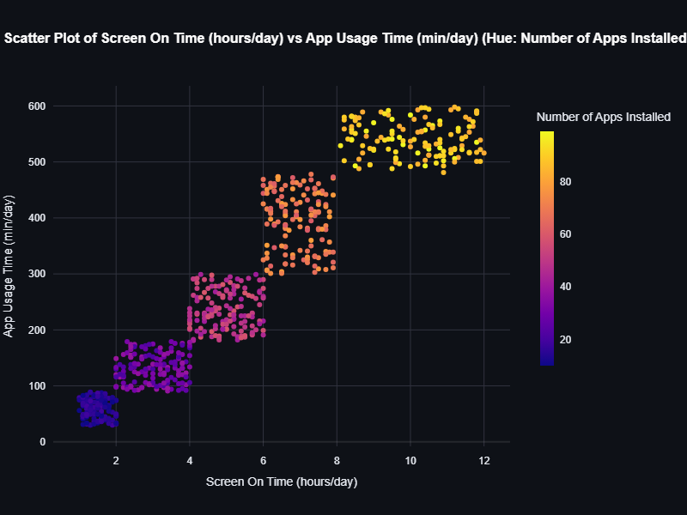
Scatter plot
Scatter plot is only available for numerical attributes.
Visualizing Relationships: Displays the relationship between two numerical attributes to identify correlations and patterns.
Select X and Y Axes: Customize axes by choosing specific numerical attributes for focused analysis.
Data Points Customization:
Color Coding: Differentiate data points by categories for better visualization.
Size Variation: Adjust point sizes to represent an additional variable.
Trend Line Option: Add a trend line to highlight overall trends and relationships.
Outlier Identification: Visually identify outliers for deeper analysis of anomalies.
Interactive Features: Hover over points for detailed information, enhancing exploration.
Export Options: Downloadable as an image or data file for reporting purposes.

Slide 25
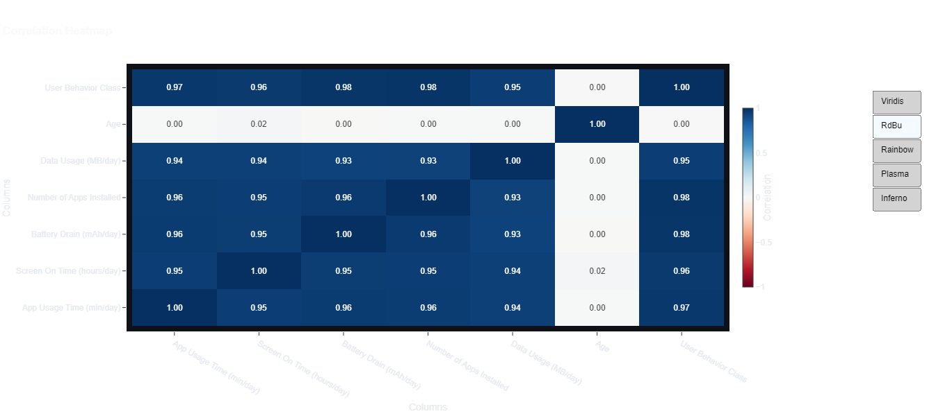
Correlation Matrix:
Visualizing Relationships: The correlation matrix provides a comprehensive view of the relationships between multiple numerical attributes, highlighting how variables are related.
Select and Deselect Columns: Users can customize the matrix by selecting or deselecting specific columns to focus on relevant variables for analysis.
Heatmap Customization:
Color Selection: Users can change the color scheme of the heatmap to enhance visual appeal and clarity, making it easier to interpret correlation strengths.
Correlation Coefficients: The matrix displays correlation coefficients, ranging from -1 to 1, indicating the strength and direction of relationships between variables.
Interactive Features: Users can hover over cells to view specific correlation values, facilitating a deeper understanding of data relationships.
Export Options: The correlation matrix can be downloaded as an image or data file for reporting and further analysis.

Slide 26
Summary
The Streamlit web app is designed for interactive data visualization and exploratory data analysis (EDA), providing a user-friendly tool for data analysts. Key features include:
Easy Dataset Upload: Users can upload datasets effortlessly and perform essential tasks.
Wide Range of Visualizations: Generates histograms, scatter plots, box plots, line graphs, heatmaps, and more to illustrate trends and relationships in the data.
Customizable Features: Offers customizable color schemes and graph types to adapt visualizations to specific analytical needs.
Streamlined EDA Process: Automates parts of the EDA workflow, reducing complexity and allowing users to extract insights without extensive technical expertise.
Open-Source Technology: Built using Python, Pandas, and Streamlit, ensuring accessibility and no licensing costs, while handling diverse datasets efficiently.
Overall, the app enhances the analytical process, allowing users to focus on gaining meaningful insights quickly and efficiently.

Slide 27
Thank you

